Slide 1
Guardians of the Chess Grandmaster
Tomás Pettit
Supervisor:
Kevin O’Brien

Slide 2
Context & Objectives
Guardians of the Chess Grandmaster is designed to challenge and train players to think like a grandmaster. Through interactive puzzles, strategic missions, and real-time matches, users can develop tactical, positional, and endgame skills.
Proposed Solution: The proposed solution is to create an interactive digital learning platform for chess that offers guided tutorials, visual aids, and engaging practice sessions, making the learning process accessible and enjoyable for all users. By incorporating a user-friendly design, gamification, and educational modules, beginners can progress confidently from basic moves to more complex strategies at their own pace.
Objectives:
Landing: Design and develop a user-friendly. Measurable: successful user authentication and password recovery tests.
Home: It provides access to all main features. Testable: verifying navigation links, responsiveness and checking out your history data.
Play: allowing users to choose between Multiplayer or AI. Testable: ensuring profile updates are saved and displayed correctly.
Tutorial: This teaches users how to play chess, covering rules, piece movements, and strategies. Testable: ensuring tutorial content loads correctly and is accessible to new users.
Friends: enables users to add, view, search, and challenge friends within the app. Testable: confirming friend requests, acceptance, and in-game invitations work properly.
Profile: players can view and edit personal information, game history, and Settings logo. Testable: ensuring profile updates are saved and displayed correctly.
Settings: It allows customisation of preferences. Measurable: verifying that user preferences persist after restarting the app.
Logout: It safely ends the user session and redirects to the landing page. Testable: confirming friend requests, acceptance, and in-game invitations work properly.
Reasons: It connects education, technology, and cognitive development. Chess has long been recognised for its ability to enhance memory, logical reasoning, and strategic thinking.

Slide 3
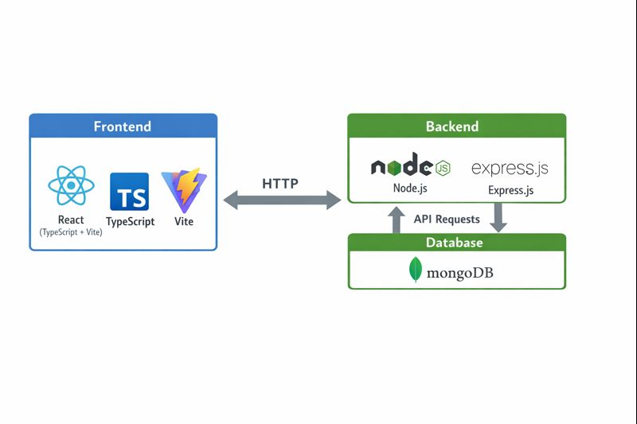
Technologies & System Architecture
Frontend: React will be used with Vite and TypeScript to build a dynamic, component-based interface. Vite provides a fast development environment and optimised build process.
Backend: the project will use MongoDB in combination with Node.js and Express.js. To provide full flexibility to define server-side logic, manage user authentication, and store game-related data efficiently.
Database: MongoDB will be used as a NoSQL document-based database. Its flexible, schema-less structure makes it ideal for handling dynamic data such as live game states and player progress.
OS: The project is web-based, so it is compatible with any OS that supports a modern web browser. To ensure flexibility for development, testing, and deployment.
Third-Party Libraries and Services: The project will integrate a few third-party libraries to simplify development and add advanced functionality.
How the high-level components interact: This interaction between components creates a cohesive architecture that supports the application’s functionalities while ensuring a smooth user experience (UX).

Slide 4

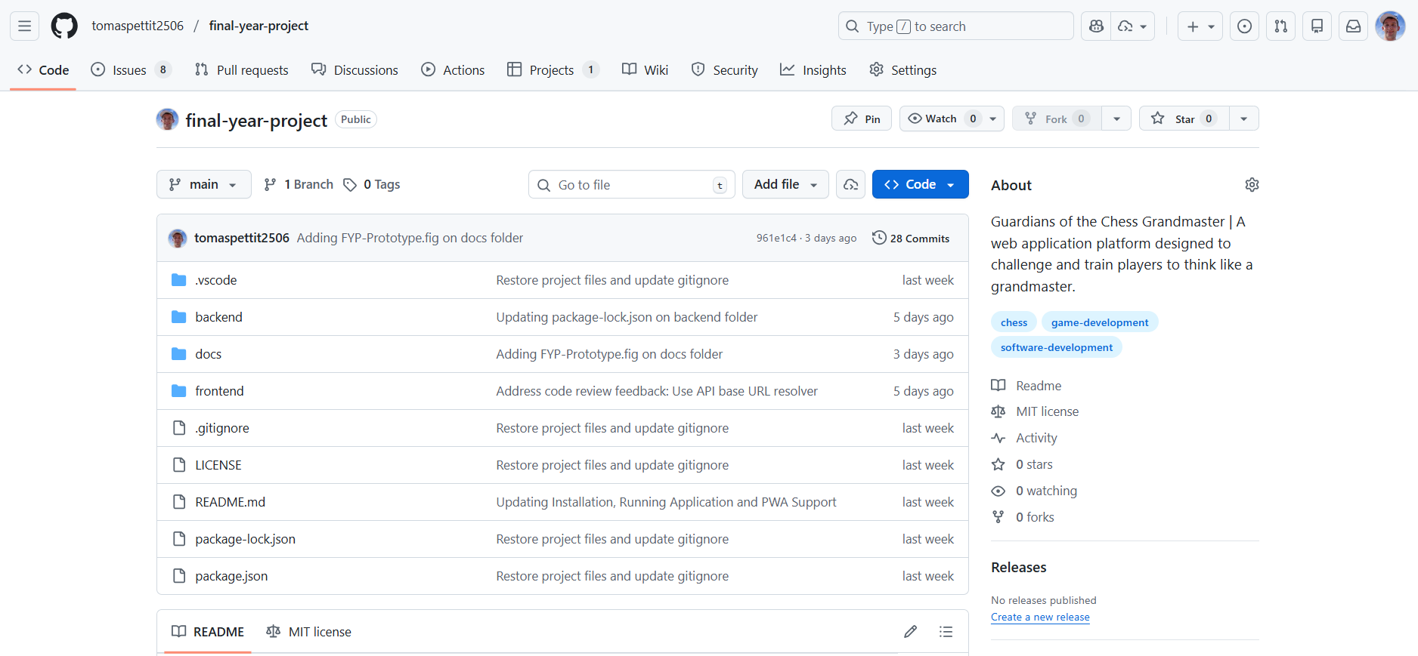
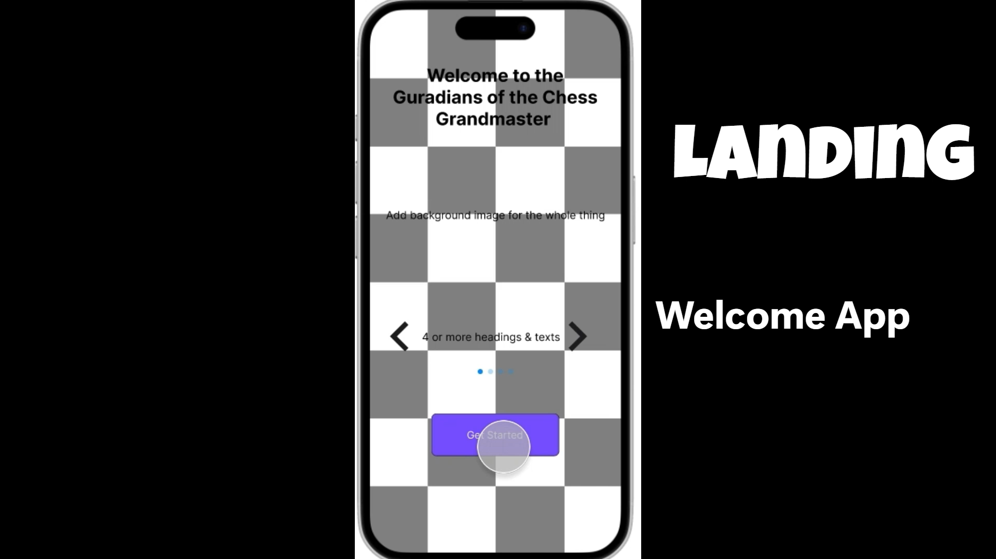
Development & Deployment
I worked on my Final Year Project (FYP):
Completed the multiplayer game (Almost)
Added more data for users, friends, requests, etc.
Started my dissertation
Objectives:
The login and signup features have been successfully implemented.
Test the recent game data before beginning multiplayer game testing.
All five tabs have been configured.
Features for clearing the cache, installing the app, and customizing the appearance have been implemented
Development of user creation, request management, and friend additions is underway.
Progress is being made on sorting out the AI and multiplayer game functionality.

Slide 5
Work Plan
Task List | Start of Date | End of Date
Project Proposal (Project Definition, Research Requirements & Gathering) | 15/9/2025 | 31/10/2025
System Architecture Planning (E.g. link on proto.io, research, AI Model, Integration) | 1/10/2025 | 5/12/2025
Frontend Development (React) | 1/11/2025 | 14/2/2026
Backend Development (Node.js OR Server.js) | 1/11/2025 | 28/2/2026
Database Setup (MongoDB) | 1/12/2025 | 31/1/2026
AI Model Development (Data Collection, Training, and Optimization) | 19/1/2026 | 15/3/2026
Integration (Frontend + Backend + Model) | 1/2/2026 | 31/3/2026
Testing & Quality Assurance | 1/11/2025 | 30/4/2026
Project Documentation & Dissertation | 1/1/2026 | 30/4/2026
Final Presentation & Submission | 1/4/2026 | 30/4/2026
Red => Todo
Yellow => In Progress
Green => Done

